Slide 1
Universal Defense Against Adversarial Attacks in Deep Learning
Tasmin Chowdhury, Mehdi Jafarnia
Supervisors: Sayandev, Eric, Keita
July 2018

Slide 2
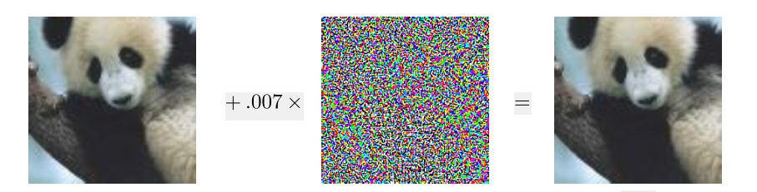

What is adversarial attack?
Intentional
Perturbation
Panda
Gibbon
Neural Networks are not learning true features
Goodfellow 2014: https://arxiv.org/abs/1412.6572

Slide 3
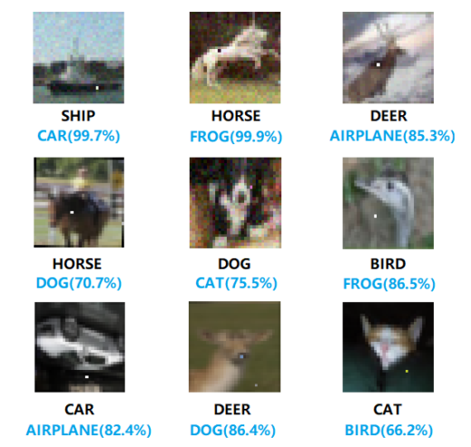
One Pixel Attack
Adversary can fool the network
on 70% of images with average
confidence of 97% by changing
only one pixel.
Su 2017: https://arxiv.org/abs/1710.08864

Slide 4
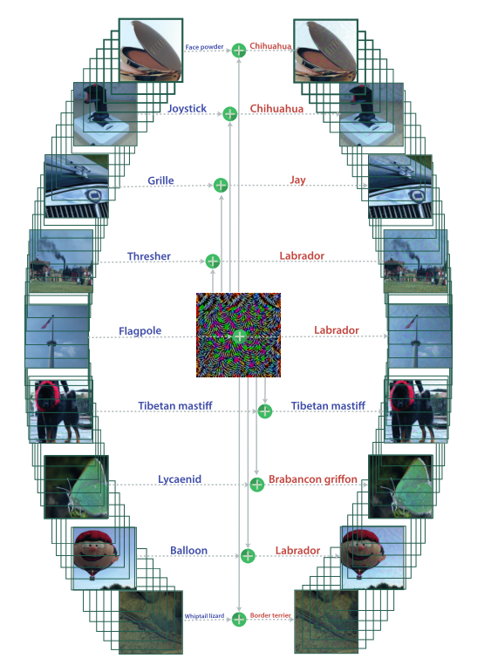
Universal Perturbation
Adversaries have too much power and freedom
Adversary can find a universal perturbation
to fool more than 80% of images
for state of the art image classifiers
Moosavi-Dezfooli 2016: https://arxiv.org/abs/1610.08401

Slide 5
Attacks and Defenses
Attacks
Defenses
FGSM
Adversarial Training
C&W
Data Compression
BIM
MIM
Data Randomization
One pixel attack
Defensive distillation
DeepFool
PGD
LBFGS
Biologically inspired protection
JSMA
Deep Cloak
Feature Adversaries
ENM
Parseval Networks
VAM
Gradient regularization
SPSA

Slide 6

Strength of attacks
 | Distillation | Feature Squeezing | Adversarial Training | Thermometer Encoding (without adversarial training)
FGSM
JSMA
C&W
PGD
Defense
Attack
weak
weak
medium
strong
All defenses proposed so far, are defeated by some algorithm

Slide 7
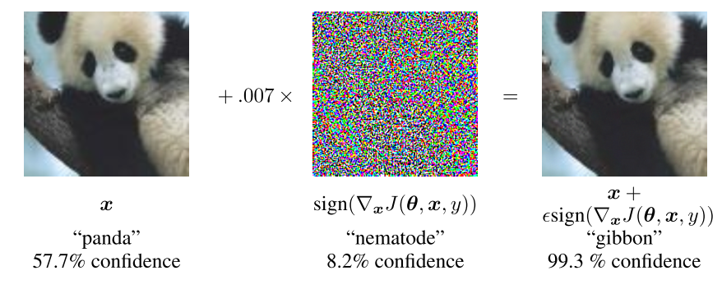
How do attacks usually work?
A Simple Attack: Fast Gradient Sign Method (FGSM) (Goodfellow 2014)
Adversaries usually solve an optimization problem to move the image towards the boundary of classifier

Slide 8
White Box Attack
Adversary has complete access to the network
Neural Network
Clean Image
Adversary
Adversarial Image

Slide 9
Black Box Attack
Output probabilities of Neural Network
Clean Image
Adversary
Adversarial Image
Black Box Attack Steps:
Adversary trains its own model by probing the target model with some images
Generate adversarial example on the trained model
Generated adversarial examples can fool the target model
Thus, if a defense model performs well on whitebox attack, it should perform well on blackbox
-madry et al.2017

Slide 10

Remarks
Neural networks are not learning true features
Adversaries have too much power and freedom
Adversarial examples are transferable among networks
Random noise can hardly fool the network
Neural networks can learn and generalize well on clean data (although we don’t know what they are learning)
Can we use these properties to guard against adversarial examples?

Slide 11

Idea: Hide Input Space
Neural Network
Clean Image
Adversary
Adversarial Image

Slide 12
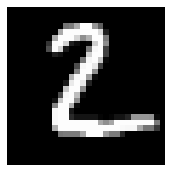
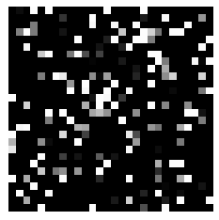
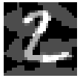
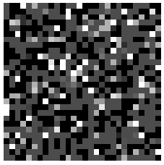
First Idea: Random Permutation
Fix a random permutation
Train your network based on permuted image
Seed
95% test accuracy
on clean images
Random
Permute
Train CNN
Results in 18% accuracy
Generated by FGSM method with unpermuted CNN
Results in 3% accuracy on unpermuted CNN

Slide 13
Why Random Permutation didn’t work?
Important pixels in unpermuted image are still important pixels in the permuted image no matter what seed is used

Slide 14
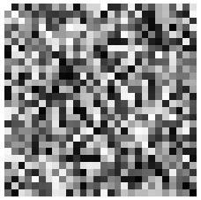
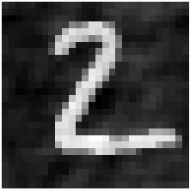
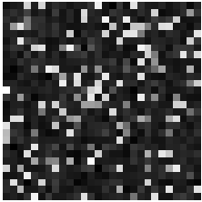
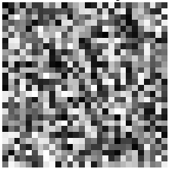
Second Idea: Permutation + Fourier
Fix a random permutation
Train your network based on phase of permuted images
Seed
93% test accuracy
on clean images
Random
Permute
Phase of
2-dim DFT
Train CNN
Generated by FGSM method on phase domain for unpermuted CNN
Results in 60% accuracy on unpermuted CNN
Achieves 90% Accuracy

Slide 15
Can we reach higher accuracies?
Yes, by ensemble of 10 models we can achieve:
96% on clean images
95% on FGSM adversarial images

Slide 16
Pipeline
The main pipeline is the following
Adversary can attack
on pixel domain
Adversary can attack
on phase domain
Permutation
Phase
NN
Predict
So the philosophy of our work was to hide the seed and reveal everything else

Slide 17
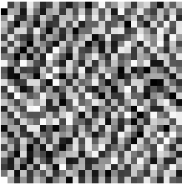

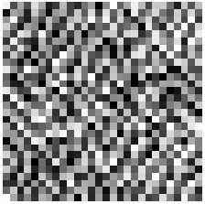
Attack Block Diagram
Unpermuted Neural Network
2-dim DFT
Attack Algorithm
Pixel Domain
Phase
Magnitude
Adversarial Phase
Inverse 2-dim DFT
Adversarial Image

Slide 18
Performance of attacks on Phase Domain
Attack | Accuracy of Unpermuted Model on Adversarial Phase | Accuracy of Unpermuted Model on Adversarial Images | Accuracy of Permuted Model on Adversarial Images | Accuracy of Ensemble of 10 Permuted Models on Adversarial Images
FGSM | 30% | 62% | 90% | 94%
MIM | 2.96% | 18% | 86% | 92%
C & W | 4.2% | 63% | 91% | 95%
PGD | 21% | 62% | 84% | 92%
DeepFool | 3.15% | 88% | 91% | 95%
VAM | 90% | 92.5% | 93% | 96%
LBFGS | 9.8% | 85.5% | 90% | 95%
ENM | 3.2% | 87% | 91% | 95%
BIM | 7.7% | 42% | 91% | 95%

Slide 19
Performance of attacks on Pixel Domain
Attack | Accuracy of after attacking permuted Model on seed 100 | Accuracy of permuted Model on other seeds
FGSM | 89% | 95.4%
MIM | 48% | 85%
C & W | 9% | 91.7%
PGD | 82% | 96%
VAM | 95% | 98%
BIM | 70% | 95%

Slide 20
Attack Block Diagram
Unpermuted Neural Network
2-dim DFT
Attack Algorithm
Pixel Domain
Phase
Magnitude
Adversarial Phase
Inverse 2-dim DFT
Adversarial Image
Can adversary attack the magnitude domain?

Slide 21
Can Adversary attack the magnitude domain?
Since the neural network is trained in the phase domain, it is not still very clear how adversary can effectively attack the magnitude domain, but following analysis shows that adversary will have little hope for attacking magnitude domain

Slide 22
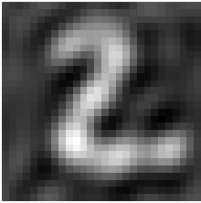
Can Adversary attack the magnitude domain?
Unpermuted Neural Network
2-dim DFT
Attack Algorithm
Pixel Domain
Phase
Magnitude
Adversarial Phase
Inverse 2-dim DFT
Adversarial Image
still 93% accuracy
on permuted networks

Slide 23
Can Adversary attack the magnitude domain?
NO, if adversary wants the image to be imperceptible to human eye, he has to keep the low frequencies unchanged, and that’s what we need to get high accuracy

Slide 24
What if adversary uses permutation to attack?
Unpermuted Neural Network
Seed 1 Neural Network
permute
2-dim DFT
Attack Algorithm
Pixel Domain
Phase
Magnitude
Adversarial Phase
Inverse 2-dim DFT
Adversarial Image
75% accuracy on Seed 1
92% accuracy on hidden Seed
Seed 1
unpermute
Adversarial Image

Slide 25
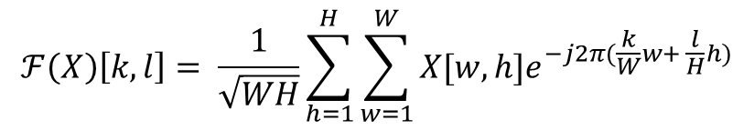
Why combining permutation and phase is expected to be effective on any attack?
$$ℱ\left(X\right)\left[k, l\right]= \frac{1}{\sqrt{WH}}\sum_{h=1}^{H}{\sum_{w=1}^{W}{X[w,h]e^{−j2π(\frac{k}{W}w+ \frac{l}{H}h)}}}$$
Values of pixels in the Fourier domain do not depend on values of individual pixels in the pixel domain. Instead, they depend on frequency of change across neighboring pixels.
But adversary does not know what neighboring pixels are because of random permutation. So, important pixels are not preserved anymore by adding Fourier block.

Slide 26
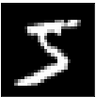
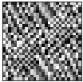

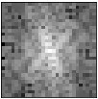
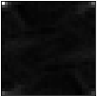
Why Phase? Why not Magnitude?
Phase has almost all information of the image
2-dim DFT
Inverse DFT
Magnitude = 1
Pixel Domain
Phase
Reconstructed from phase only
Magnitude
Inverse DFT
Phase = 0
Reconstructed from magnitude only

Slide 27
Results on Cifar 10 Dataset
we used the same architecture for cifar 10 as well.
it worked better plus we wanted to train on simple models rather than complicated deep Resnets.

Slide 28
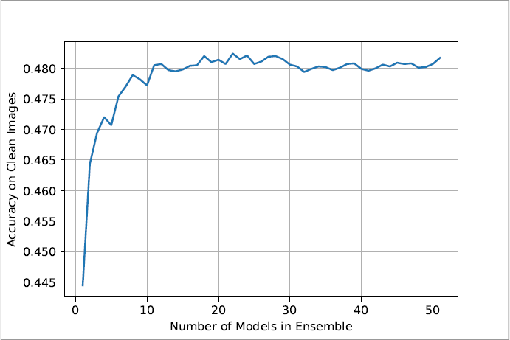
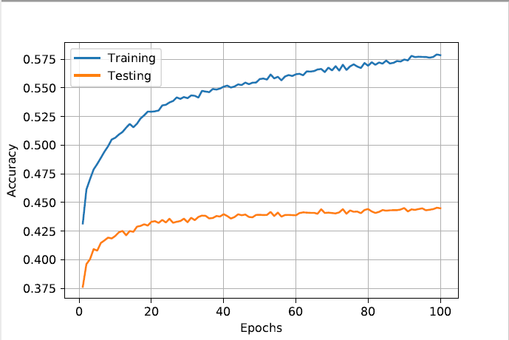
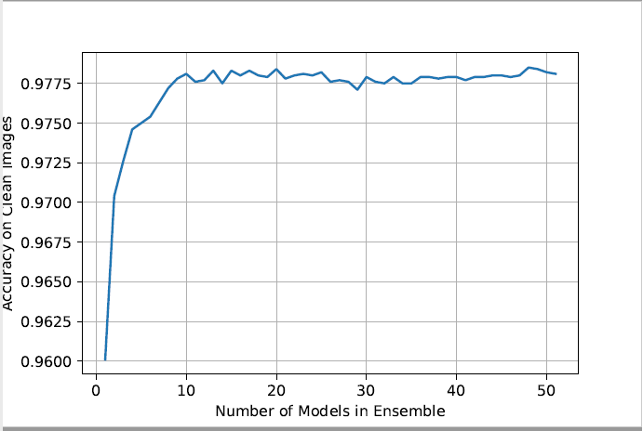
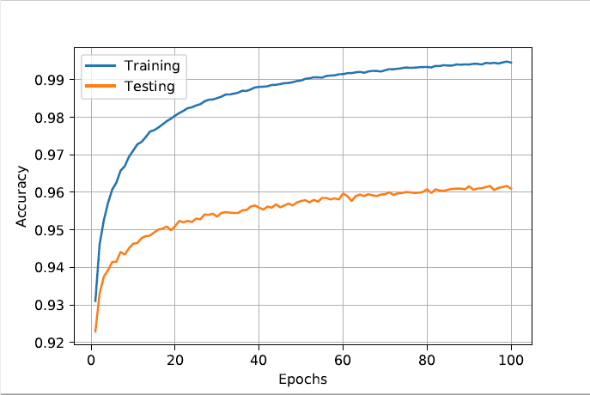
Accuracy before attack for Cifar 10 & Mnist
C
I
F
A
R
10
M
N
I
S
T

Slide 29
Acuuracy of Cifar 10 after attack on Pixel Domain
Attack | Accuracy of permuted Model on Seed 100 | Accuracy of Permuted Model on other seeds
FGSM | 30% | 47.2%
MIM | 14% | 18%
C & W | 11.11% | 46.7%
PGD | 33.6% | 47.2%
VAM | 28% | 42%
BIM | 17% | 31.6%
DeepFool | 27.1% | 44%

Slide 30
Final Points and Summary
Universal defense against adversary is possible if we hide input space
Random permutation followed by Fourier transform effectively hides the input space, so adversary attacks will not be more effective than just random noise
Ensemble of a few permuted phase models helps to increase accuracy on both clean and adversarial images
Accuracies given here are before hyper parameter tuning, we might achieve even better results after tuning

